Slide 1
Secure Instant Point-to-Point (P2P) Messaging

Slide 2
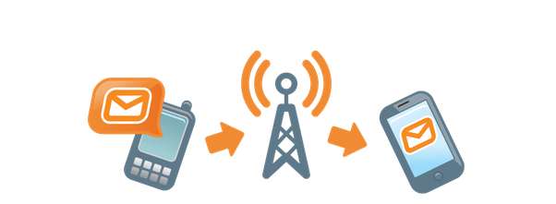
Project Description
• Alice and Bob can use the tool to send instant messages to each other.
• Alice and Bob share the same password (or passphrase), they must use the password to set up the tool to correctly encrypt and decrypt messages shared between each other.
• Each message during Internet transmission must be encrypted using a 56-bit key.

Slide 3
Details
Python3
Using pyDES, Crypto, and hashlib
+User verification
+Secure key generation
+Encrypted message exchange

Slide 4
Socket
Building socket: (socket.AF_INET, socket.SOCK_STREAM )
Host and port: (sock.bind())
Connect: socket .listen() and socket.accept()

Slide 5
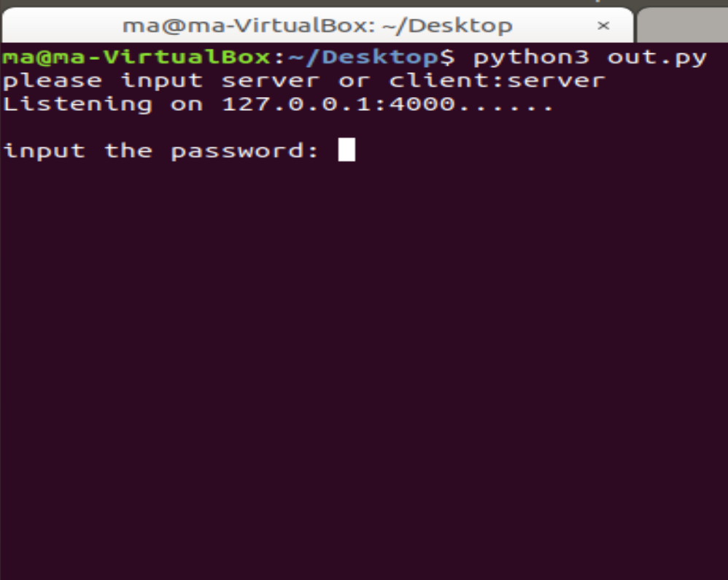

Slide 6
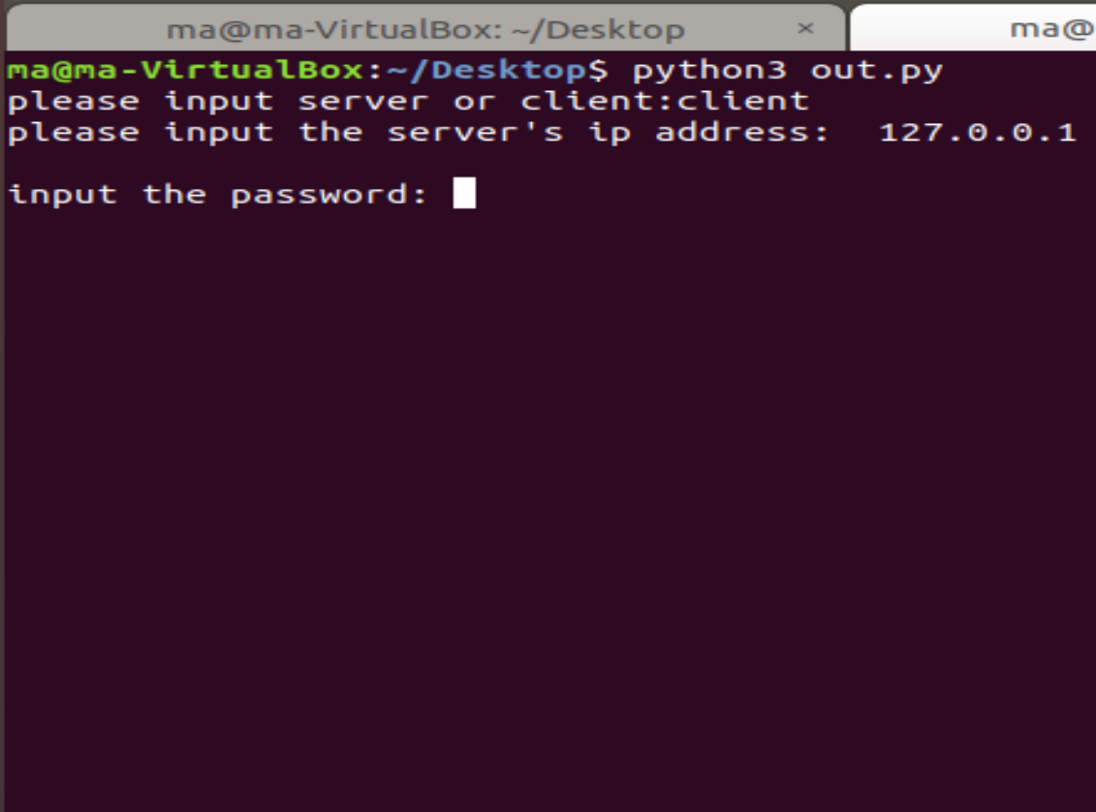

Slide 7
Key Exchange
In order to decode the password that verify the identity.
Producing the key:
key=RSA.generate(keysize, random_generator)
Private,public = key, key.publickey()
Exchange: sock.send and sock.recv.

Slide 8
Password Verification
Both of server and client input the password.
Encrypting the password: cipher = PKCS1_OAEP.new(public_key)
Decrypting the password: password = PKCS1_OAEP.new(private_key).decrypt(cipher)
Match -- verification

Slide 9
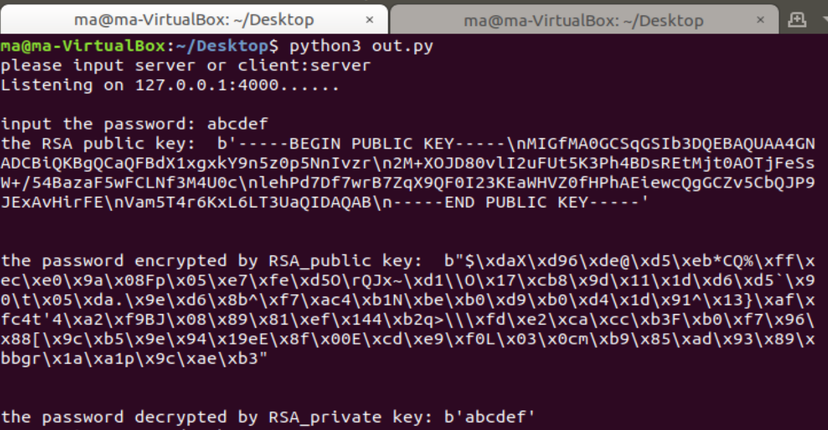

Slide 10
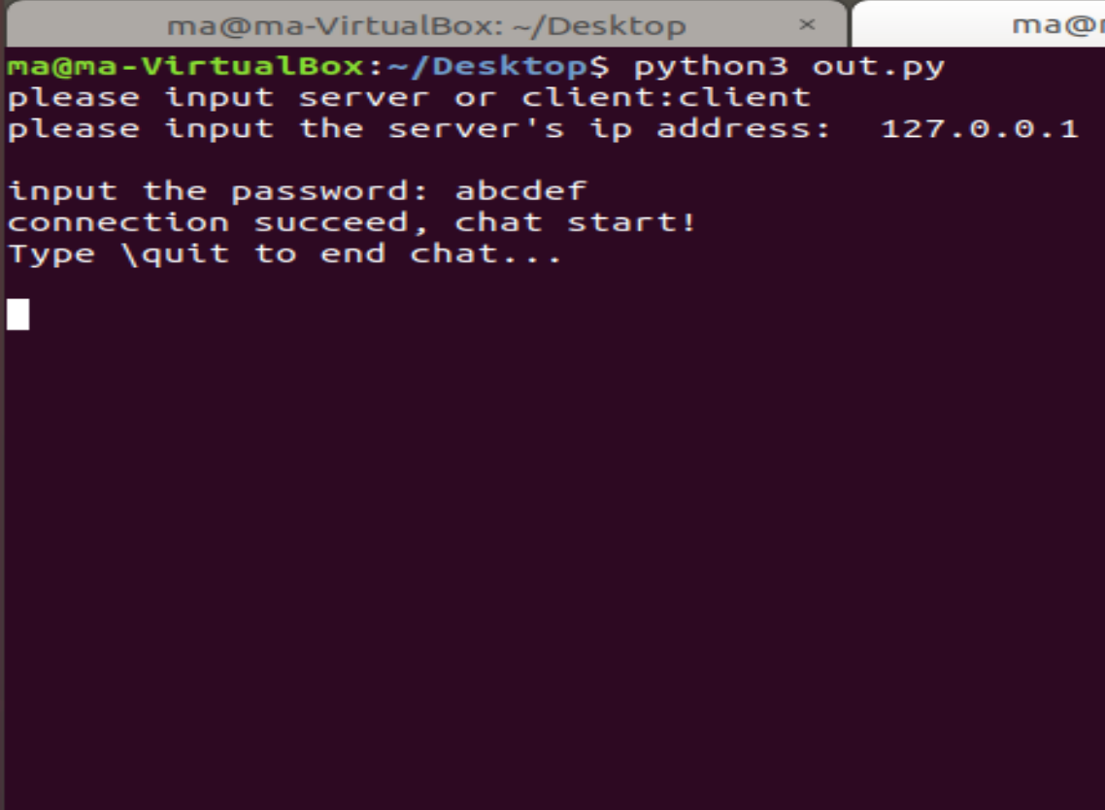

Slide 11
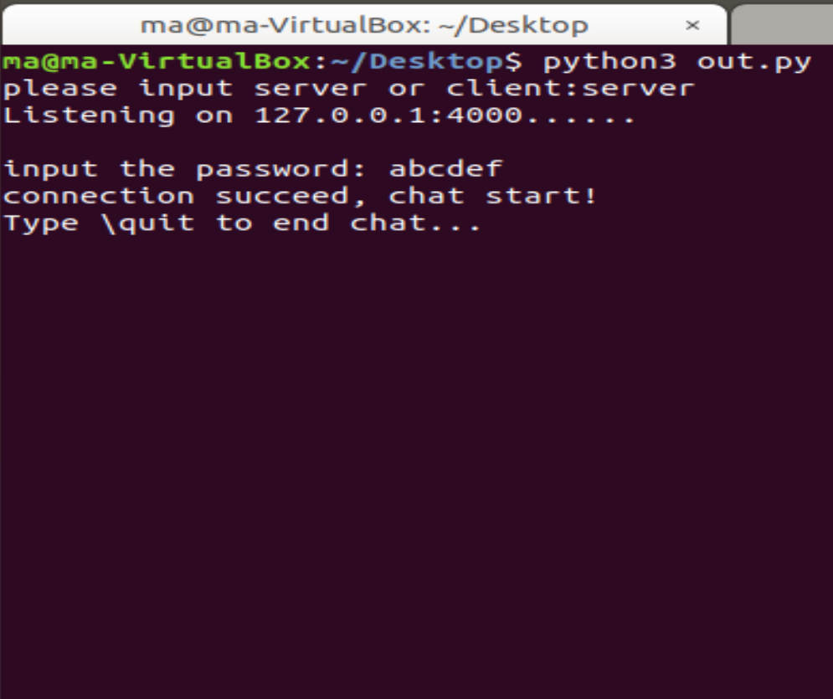

Slide 12
Password-Based Key Derivation
PBKDF2: Password-Based Key Derivation
DK = PBKDF2(PRF, Password, Salt, c, dkLen)
PRF is a pseudorandom function of two parameters with output length hLen (e.g., a keyed HMAC)
Password is the master password from which a derived key is generated
Salt is a sequence of bits, known as a cryptographic salt
c is the number of iterations desired
dkLen is the desired bit-length of the derived key
DK is the generated derived key
Part of Public-Key Cryptography Standards (PKCS#5)
Using SHA256 as PRF

Slide 13
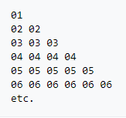
Message Encryption/Decryption
pyDes.des(key, [mode], [IV], [pad], [padmode])
Key = the DK from PBKDF2
Mode = CBC
Padmode= PKCS #5
+Error Detection/Recovery

Slide 14
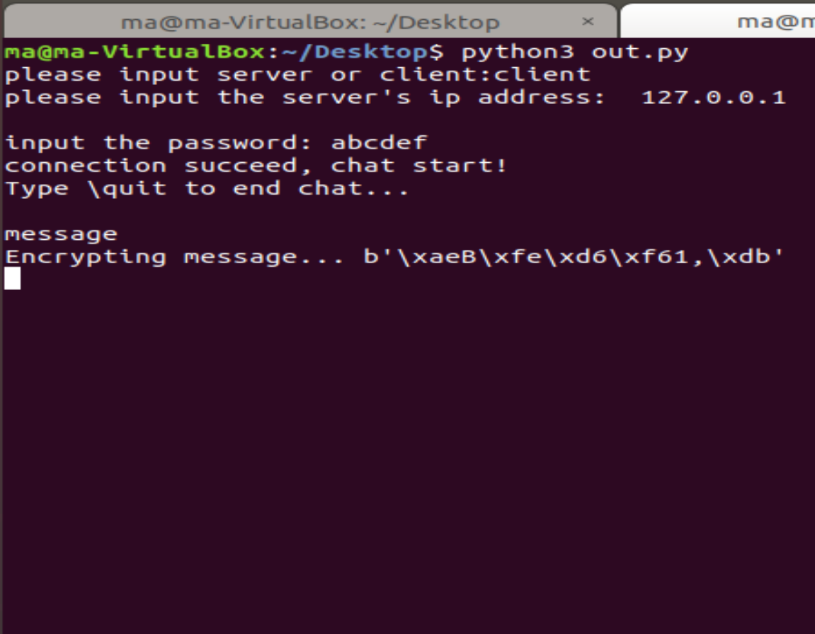

Slide 15
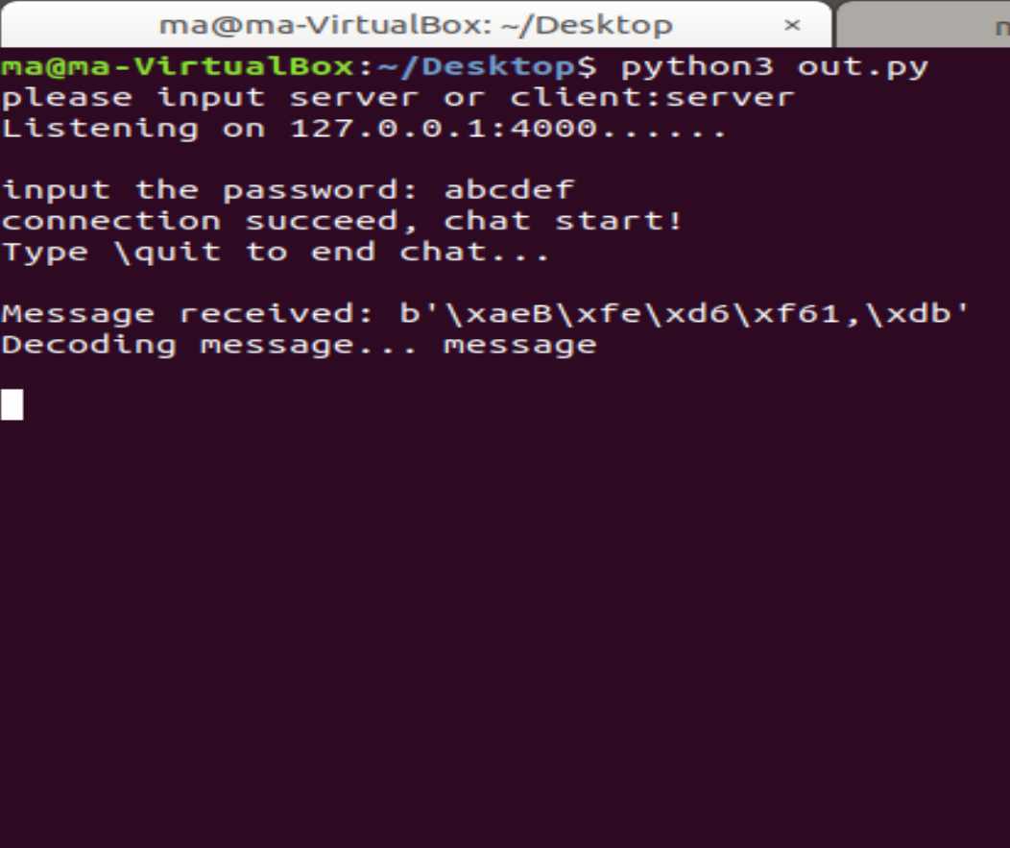

Slide 16
Exit

